Slide 1

Gravimetry Mission
Javier Navarro

Slide 2
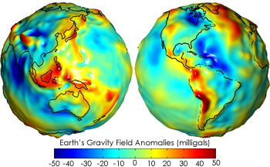
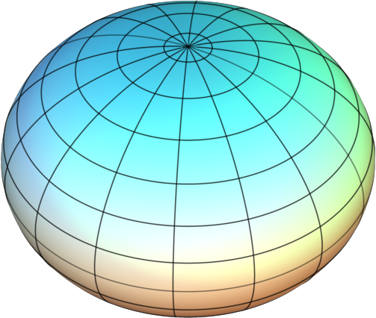
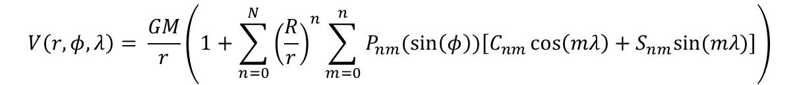
Gravimetry mission
Context
Reference ellipsoid
Earth gravity field
The non uniformity of Earth’s gravity field is caused by :
Earth flattening
Surface relief
Mass distribution
Le Geoide :
Reference equipotential surface of Earth’s gravity field
Simplified mathematical model to describe Earth shape
WGS84
$$V\left(r,φ,λ\right)= \frac{GM}{r}\left(1+\sum_{n=0}^{N}{{\left(\frac{R}{r}\right)}^{n}}\sum_{m=0}^{n}{P_{nm}(\sin\left(φ\right))\left[C_{nm}\cos\left(mλ\right)+S_{nm}sin⁡(mλ)\right]}\right)$$

Slide 3
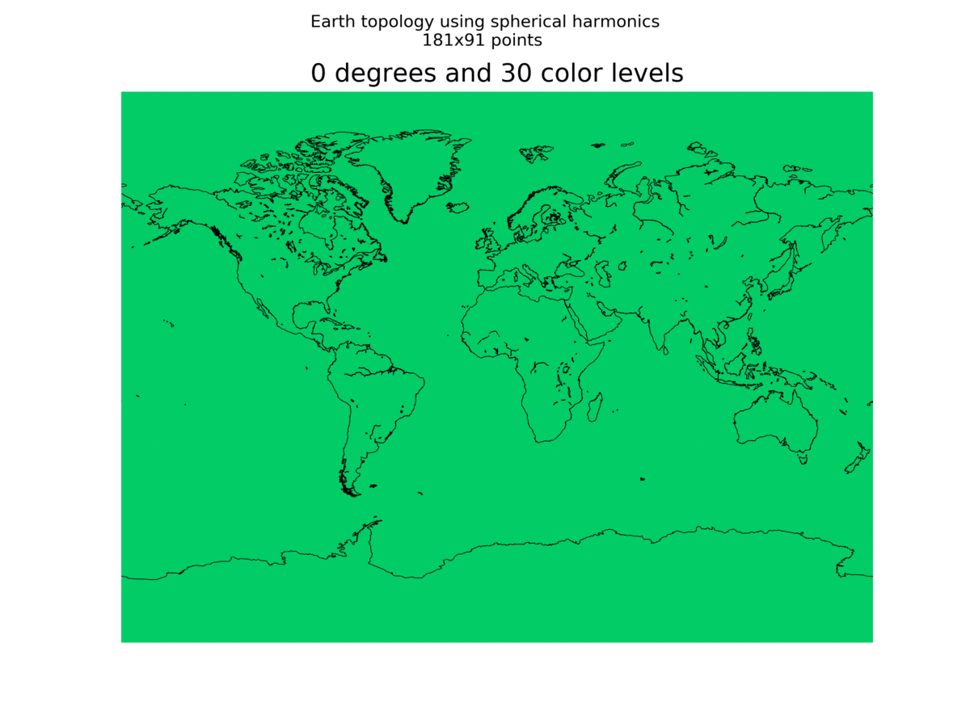
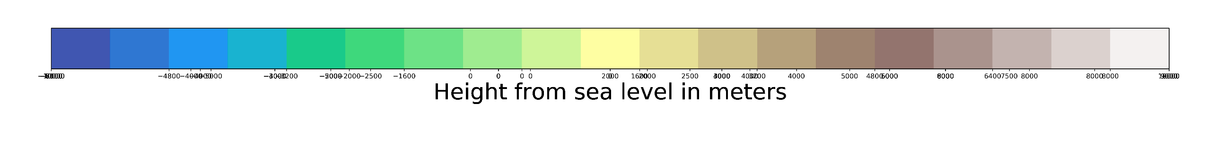
Gravimetry mission
Context : Order (n) influence on the model

Slide 4


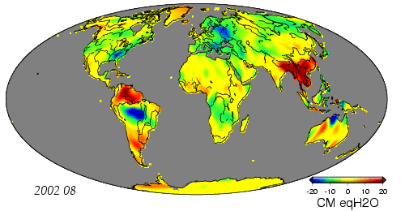
Gravimetry mission
Context : Space missions
NASA
Launched in 2002 (GRACE) and 2018 (GRACE-FO))
GRACE A and GRACE B distance measured using k-band microwaves
400 -500 km space resolution
ESA
Launched in 2009
Acceleration measures with accelerometers
Less than 100 km space resolution
Time-variable Earth gravity field

Slide 5
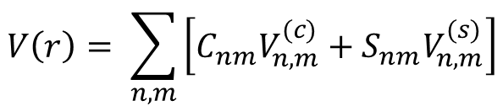
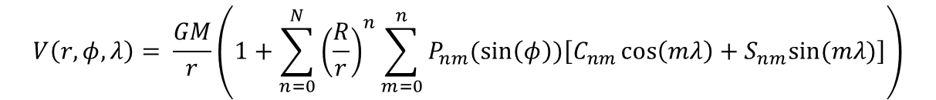
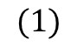
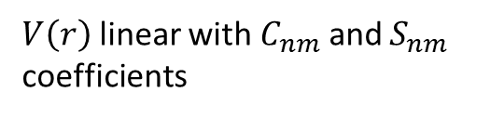
Gravimetry mission
Method : Acceleration aproach
Developped by Ales Bezdek and Josef Sebera in 2014 in the paper : : Gravity field models from kinematic orbits of CHAMP, GRACE and GOCE satellites
This method gives geoid models from GNSS measurement from LEO satellites
$$V\left(r,φ,λ\right)= \frac{GM}{r}\left(1+\sum_{n=0}^{N}{{\left(\frac{R}{r}\right)}^{n}}\sum_{m=0}^{n}{P_{nm}(\sin\left(φ\right))\left[C_{nm}\cos\left(mλ\right)+S_{nm}sin⁡(mλ)\right]}\right)$$
We can write :
$$V\left(r\right)= \sum_{n,m}{\left[C_{nm}V_{n,m}^{(c)}+S_{nm}V_{n,m}^{(s)}\right]}$$
$V\left(r\right)$linear with $C_{nm}$ and $S_{nm}$ coefficients
$$(1)$$

Slide 6
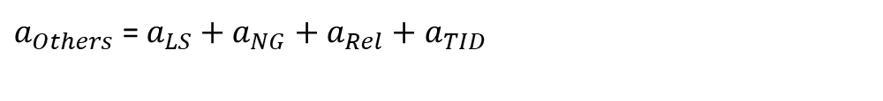
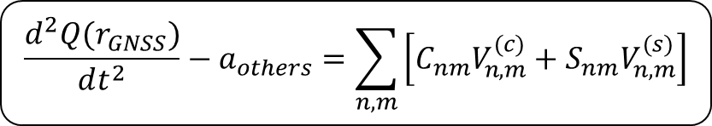
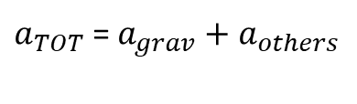
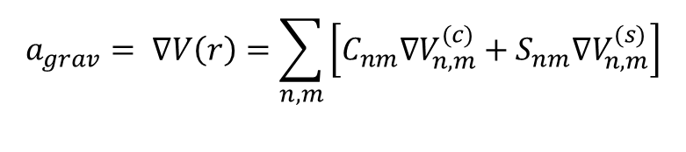
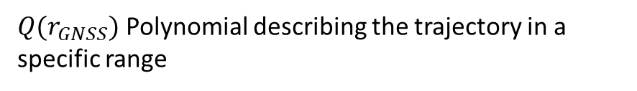
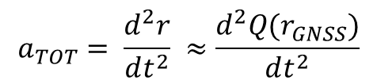
Gravimetry mission
Méthode : Acceleration Aproach
According to Newton second low, the forces applied on the satellite generate accelerations :
$a_{TOT}$ = $a_{grav}+a_{others}$
with :
$a_{Others}$ = $a_{LS}+a_{NG}+a_{Rel}+a_{TID}$
$$a_{TOT}= \frac{d^{2}r}{dt^{2}} ≈\frac{d^{2}Q(r_{GNSS})}{dt^{2}}$$
with :
$Q(r_{GNSS})$ Polynomial describing the trajectory in a specific range
$$a_{grav}= ∇V\left(r\right)=\sum_{n,m}{\left[C_{nm}∇V_{n,m}^{(c)}+S_{nm}∇V_{n,m}^{(s)}\right]}$$
$$\frac{d^{2}Q(r_{GNSS})}{dt^{2}}−a_{others}=\sum_{n,m}{\left[C_{nm}V_{n,m}^{(c)}+S_{nm}V_{n,m}^{(s)}\right]}$$

Slide 7
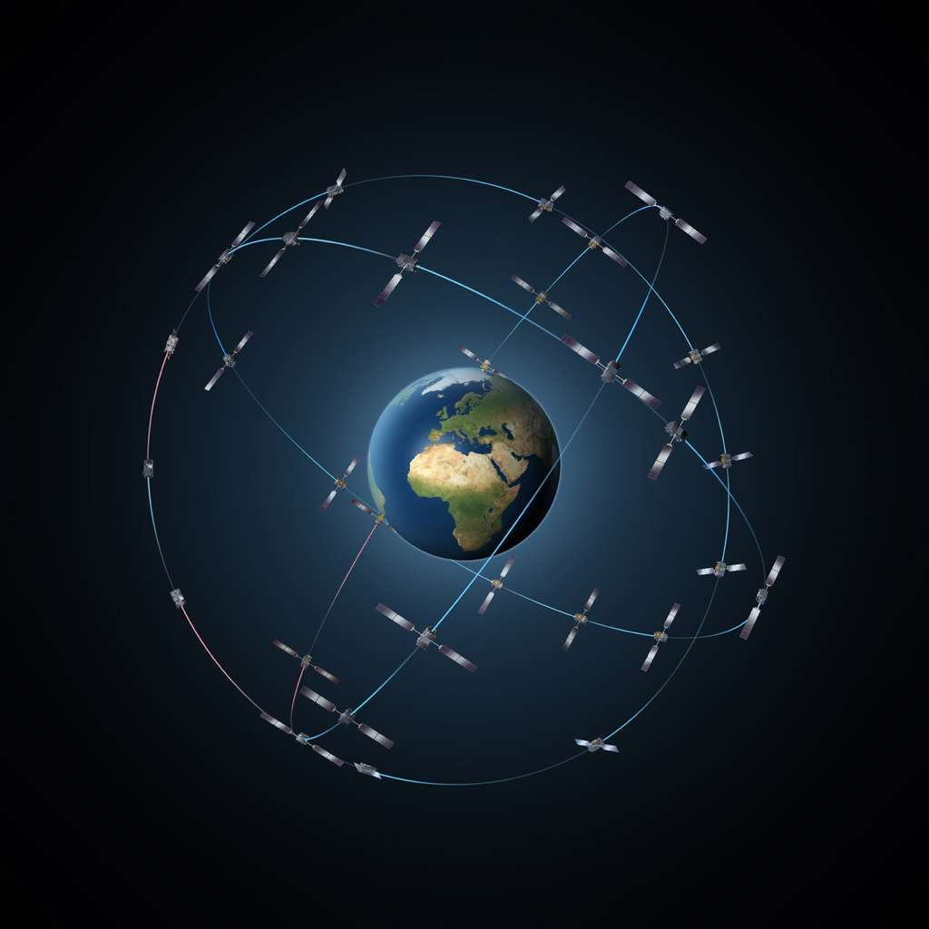
Gravimetry mission
Objectifs
Measure time-variable Earth gravity field with at least 1200 km accuracy
Use Galileo signal for Precise Orbit Determination (POD)
Motivations and applications
« Acceleration approach » : simple and low-cost application
Possibility of having a CubeSat constellation measuring Earth gravity field in realt-time
Analysis on Galileo constellation improvement on precise positionning
Test and space validation of COTS components

Slide 8
Gravimetry mission
Mission requirements
Identifier | Requirement
MIS-001 | The CubeSat shall be designed to have an in-orbit lifetime of at least 5 months
MIS-002 | The system shall be able to send telemetry via the Iridium-Next constellation
MIS-003 | The system shall be able to receive telemeasure via the Iridium-Next constellation
MIS-005 | The mission shall measure time variable gravity field derived from GNSS tracking with at least 1200 km of accuracy
MIS-010 | The mission shall use Galileo signals
MIS-020 | The mission shall be adapted to “Fly Your Satellite” requirements
MIS-025 | The orbit shall be below 600 km
MIS-035 | The communications with Iridium-Next should be done via at least 1 protocol
MIS-040 | Ground stations shall include at least one that is located in Toulouse

Slide 9
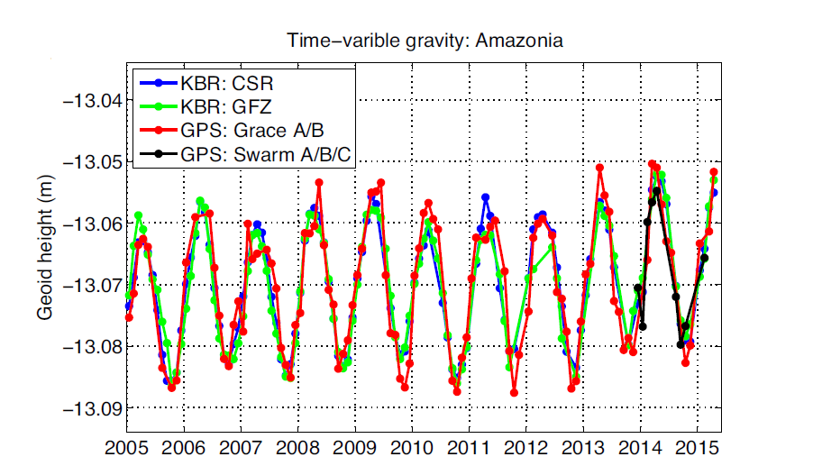
Gravimetry mission
Mission requirements
MIS-001 | The CubeSat shall be designed to have an in-orbit lifetime of at least 5 months
Minimum life time to observe time variation of the Earth gravity field

Slide 10
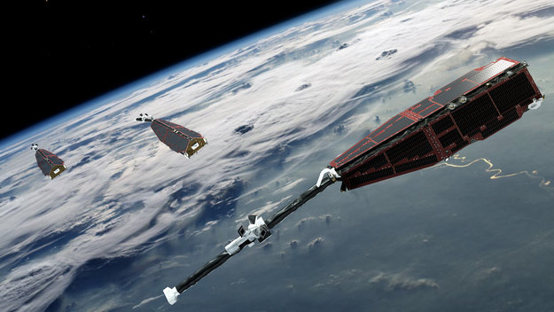
Gravimetry mission
Mission requirements
MIS-005 | The mission shall measure time variable gravity field derived from GNSS tracking with at least 1200 km of accuracy
We are going to use the « acceleration approach »
Our objective is to achieve at least the same accuracy reached with the SWARM mission, which was not adapted for this purpose

Slide 11

Gravimetry mission
Mission requirements
MIS-010 | The mission shall use Galileo signals
In order to conclude about Galileo impact on POD
In order to test new COTS functionalities

Slide 12
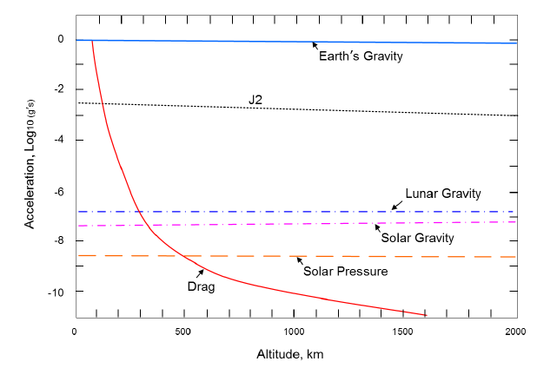
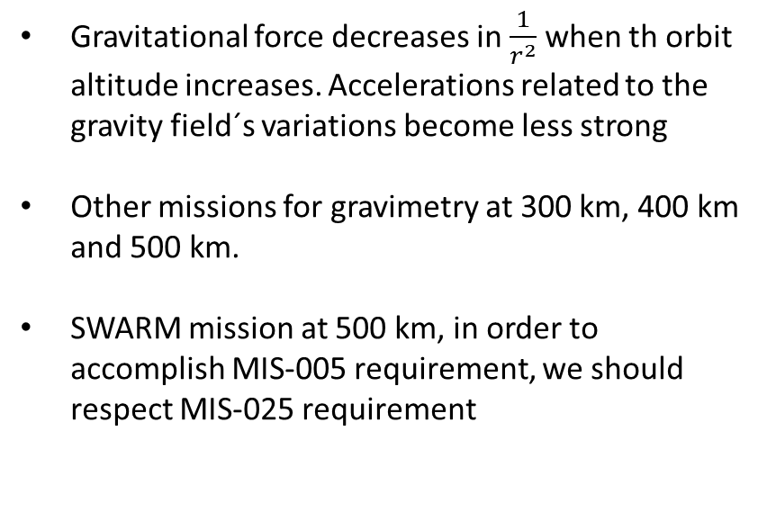
Gravimetry mission
Mission requirements
MIS-025 | The orbit shall be below 600 km
Gravitational force decreases in $\frac{1}{r^{2}}$ when th orbit altitude increases. Accelerations related to the gravity field´s variations become less strong
Other missions for gravimetry at 300 km, 400 km and 500 km.
SWARM mission at 500 km, in order to accomplish MIS-005 requirement, we should respect MIS-025 requirement

Slide 13
Gravimetry Payload system

Slide 14
Gravimetry payload
CU requirements
Identifier | Requirement
PAY-GRA-010 | The GNSS receiver shall track more than 8 GNSS satellites
PAY-GRA-020 | The GNSS receiver position acquisition frequency shall be at least 5 Hz
PAY-GRA-030 | The antenna linked to GNSS receiver shall be zenith oriented with a minimal accuracy of 54º
PAY-GRA-040 | The gravimetry payload must be adapted to PPP data processing inside the CubeSat and post-processing
PAY-GRA-050 | The gravimetry payload exit file can either be a raw binary format or a .pos
PAY-GRA-060 | The GNSS receiver shall allow multi-frequency GNSS signal acquisition
PAY-GRA-070 | The gravimetry payload shall produce enough data to generate 3 geoid models during the mission life time

Slide 15
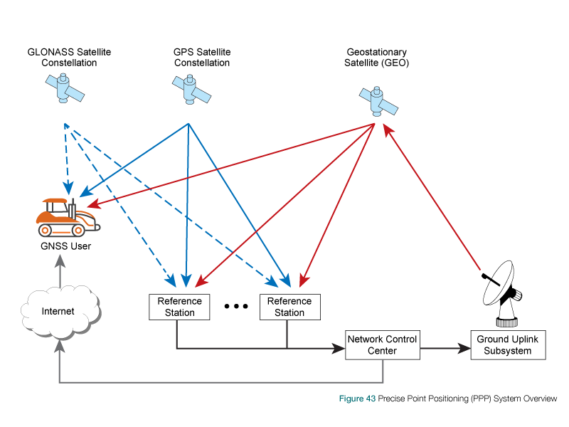
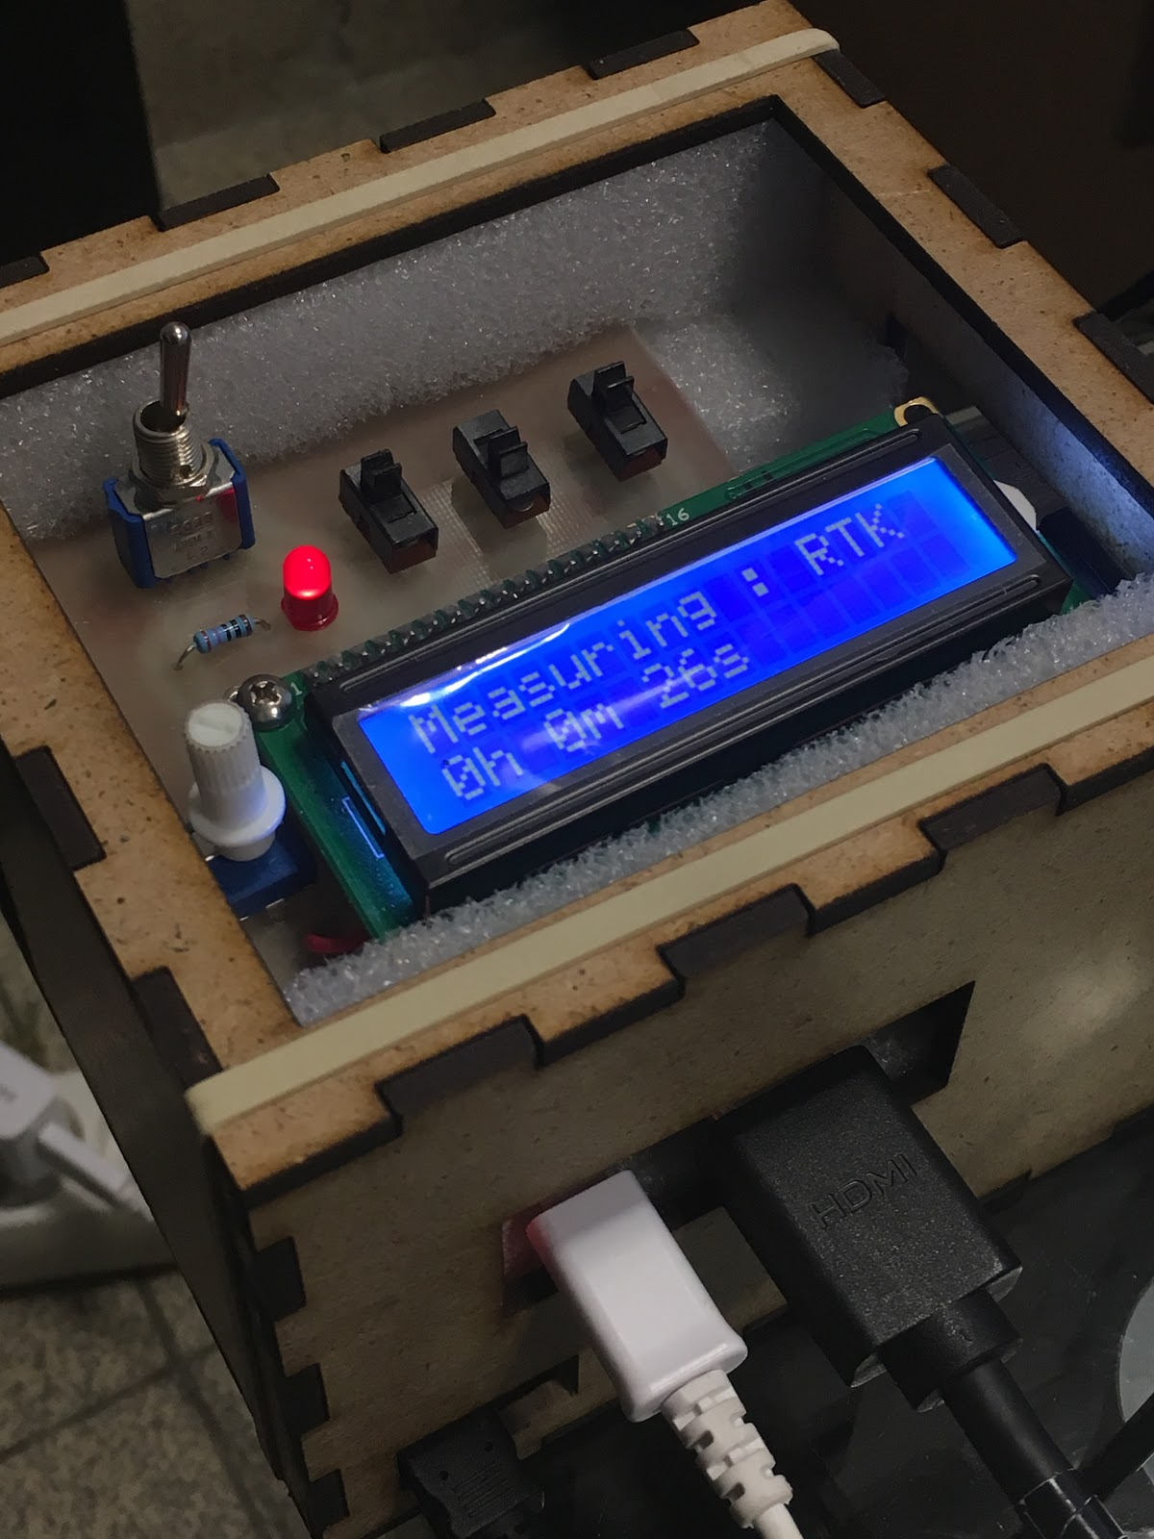
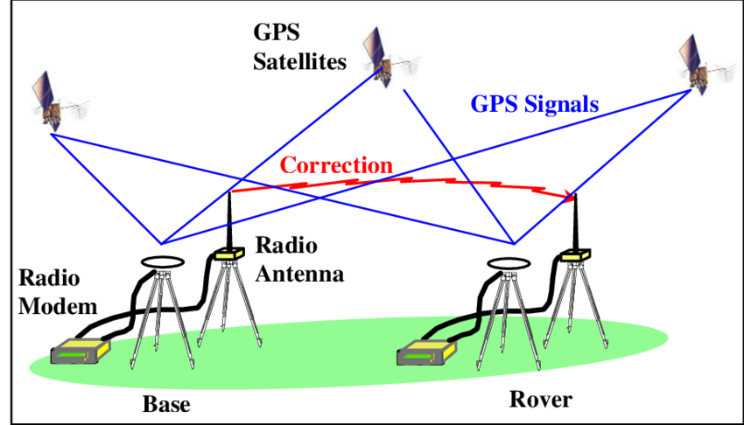
Gravimetry payload
CU requirements
INSA 4th year project : build a system to study precise geolocalisation and conclude about possible applications on a CubeSat (prototype of Tolosat gravimetry payload)
Precise Point Positioning (PPP)
vs
Real Time Kinematic (RTK)

Slide 16
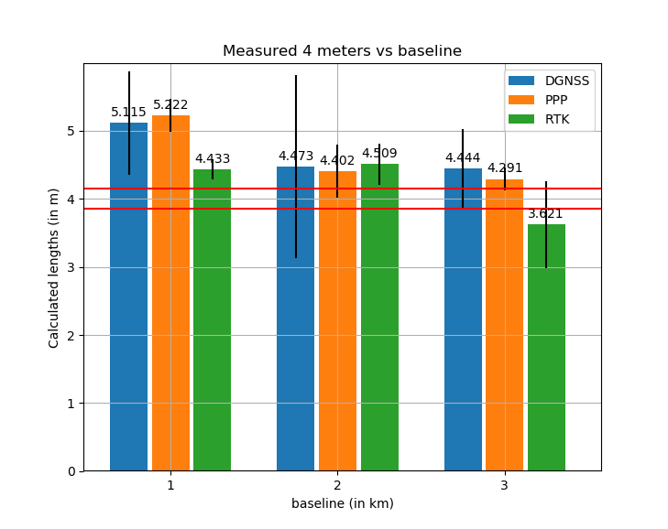
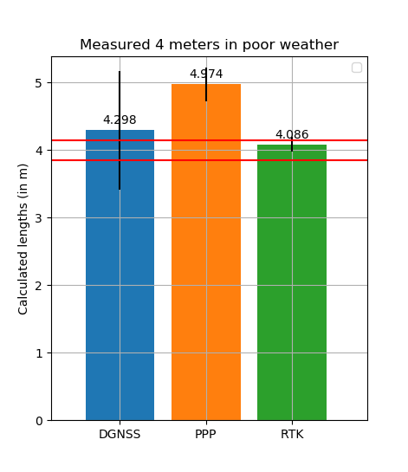
Gravimetry payload
CU requirements
PAY-GRA-010 | The GNSS receiver shall track more than 8 GNSS satellites
Accuracy increased in the second graph
Less than 1 m accuracy reached for PPP method

Slide 17
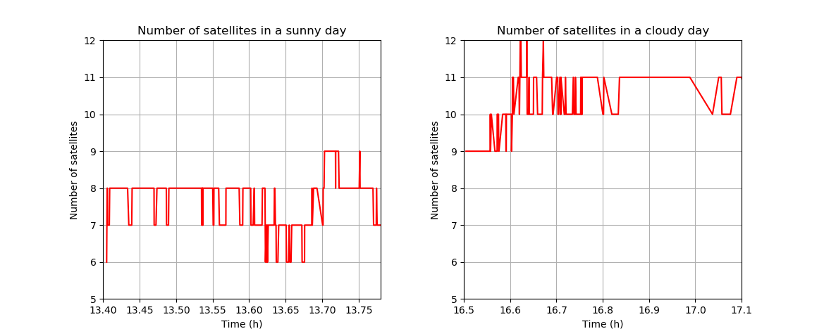
Gravimetry payload
CU requirements
PAY-GRA-010 | The GNSS receiver shall track no less than 10 GNSS satellites, and shall be capable of tracking more than 20 satellites
Second graph was taken in a cloudy day. contrary to our expectations, a better accuracy level was reached
We conclude that the number of satellites has a huge impact in geolocalisation accuracy
8 GPS satellites were used for SWARM geolocalisation

Slide 18
Gravimetry payload
CU requirements
PAY-GRA-030 | The antenna linked to GNSS receiver shall be zenith oriented with a minimal accuracy of 54º
Accuracy needed to avoid ocultation by the Earth
Hypothesis :
Elevation angle mask = 0º
54º
54º
Earth

Slide 19
Gravimetry payload
CU requirements
PAY-GRA-020 | The GNSS receiver position acquisition frequency shall be at least 5 Hz
ADCS limitation : 15% of the time in orbit, we are in a favorable orientation for the gravimetry payload (visibility windows)
Hypothesis:
Random visibility windows
Every visivility window allows the geolocalisation (not in eclipse)
Aquisition frequency : 5 Hz
Surface density of points Tolosat/swarm :
SWARM → number of points per solution (month) : $2.6·{10}^{6}points/month$
85%
Tolosat → number of points per solution (month) : $1.93·{10}^{6}points/month$
OK

Slide 20
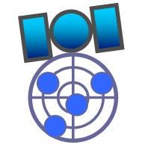
Gravimetry payload
CU requirements
PAY-GRA-040 | The gravimetry payload must be adapted to PPP data processing inside the CubeSat and post-processing
PAY-GRA-050 | The gravimetry payload exit file can either be a raw binary format or a .pos
With 15% visibility per day :
Raw measurement : 21.5 KB/min (kilobytes)
PPP measurement : 0.4 KB/min (kilobytes)
Raw measurement : 4638.2 KB/day (kilobytes)
PPP measurement : 615.7 KB/day (kilobytes)
Data reduction :
86.7 %
Possibility to use RTKLIB Open Source software as a base for PPP procesing in our CubeSat

Slide 21
Gravimetry payload
CU requirements
PAY-GRA-060 | The GNSS receiver shall allow multi-frequency GNSS signal acquisition
PAY-GRA-070 | The gravimetry payload shall produce enough data to generate 3 geoid models during the mission life time
Multi-frequency to cancel position error caused by ionospheric sintillation
3 geoid models to conclude about time-variable gravity force trend

Slide 22
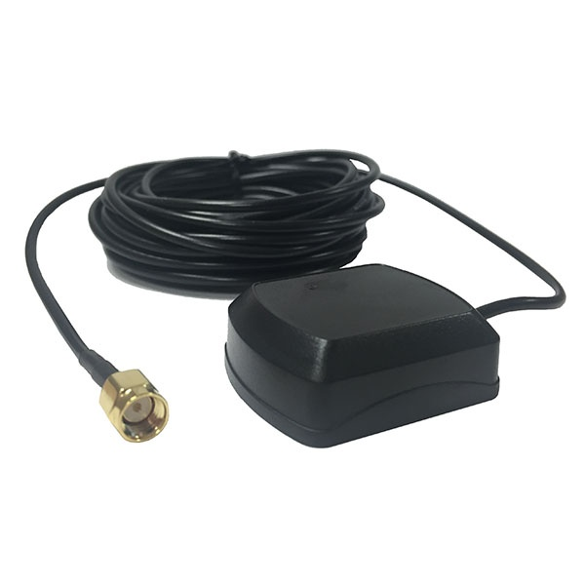
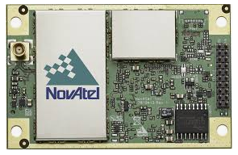
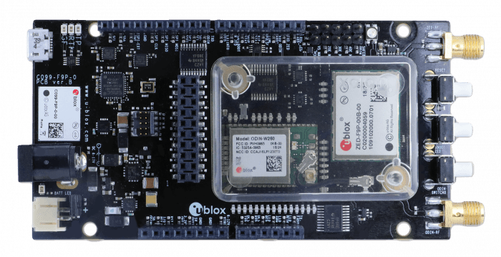
Gravimetry payload
Payload system
Accéléromètres MEMS
Replaced by modelisations as no accelerometer provides enough accuracy within acceptabledimensions
Module GNSS
Récepteur Novatel OEM7720
OBC
Patch antenna
Oscillateur externe
No need as clock bias solved with 4th satellite in geolocalisation and no more than one GNSS receiver is used
Other possibilitye we are analysing is to use ublox F9 low-cost receiver → No enough data accessible for the moment

Slide 23
Gravimetry payload
Payload system
Our progress:
Code developpement for detailed accuracy analysis of final geoid models
We have implemented the plotting of coefficients using spherical harmonics
We have to implement the acceleration approach

Slide 24
Payload Iridium Requirements
Pierres-Yves Schini

Slide 25
Iridium Requirements
PAY-IRI-001 | The satellite shall be able to execute simple missions from messages we sent through the Iridium constellation : for example request to send the general state of the satellite
PAY-IRI-002 | The communication time between the satellite and the Iridium-Next constellation shall be suficient to transmit the required data, that is at least ...
PAY-IRI-003 | The satellite shall be able to communicate with the Iridium-Next constellation often enough to have a possible communication with the Earth at least 20% of time

Slide 26
Backup slides

Slide 27


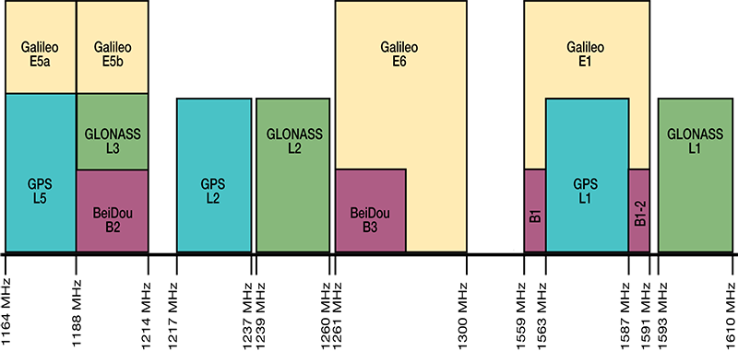
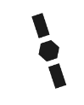
Introduction au GNSS
4 constellations GNSS, fréquences dans la bande L (1-2GHz) RHCP
TOLOSAT

Slide 28
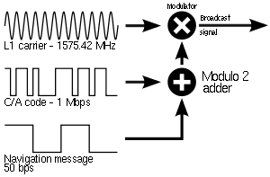
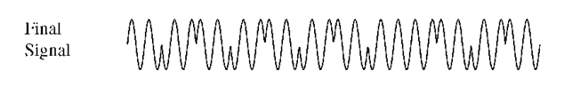
Introduction au GNSS
Exemple du signal: GPS
TOLOSAT

Slide 29
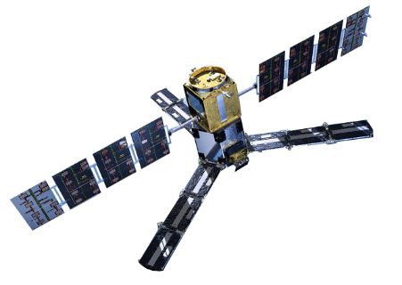
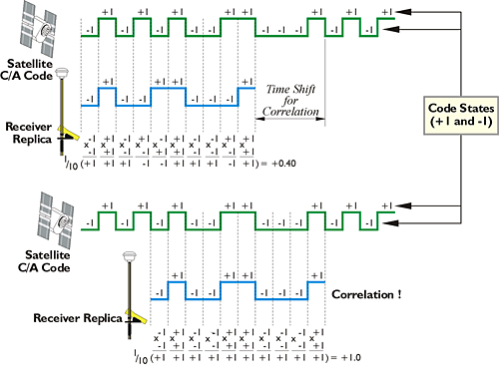
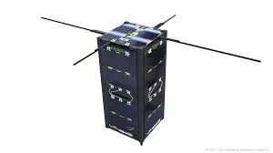
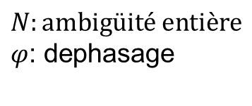

Types de mesures
Mesure de phase
Mesure de code
Corrélation
19 cm
$$d=f(N,φ)$$
$$N:ambigüité entière$$
$φ$: dephasage
TOLOSAT

Slide 30
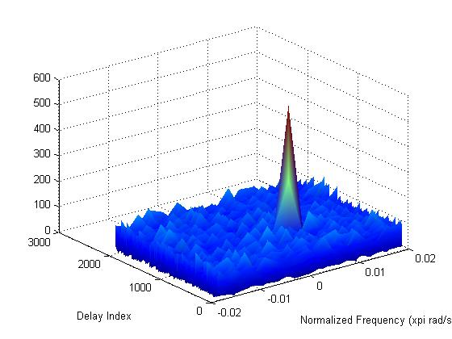
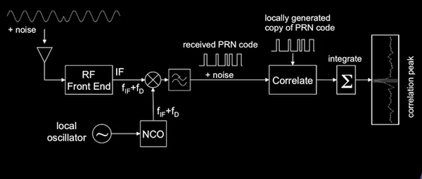
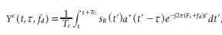
Mesure de code
TOLOSAT

Slide 31
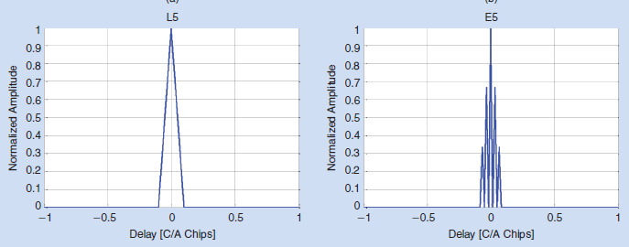
Corrélations différentes
GPS L5
Galileo E5
TOLOSAT

Slide 32
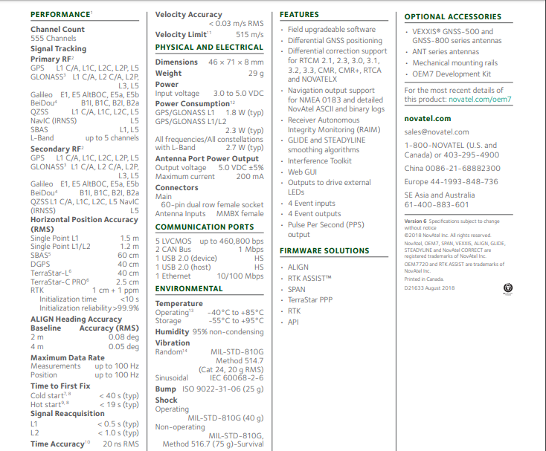
TOLOSAT

Slide 33
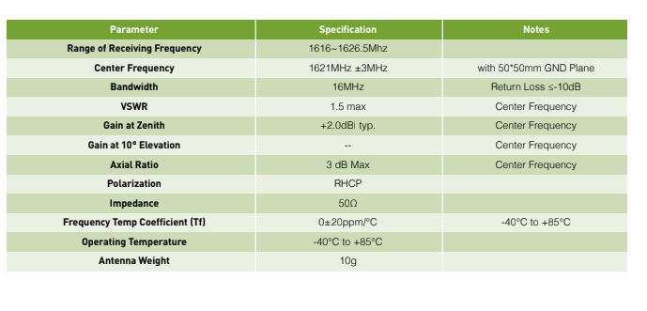
TOLOSAT

